Slide 1


LESSON 7
TRIGONOMETRIC IDENTITIES

Slide 2
TRIGONOMETRIC IDENTITIES
A trigonometric identity is an equation involving trigonometric functions that hold for all values of the argument, typically chosen to be θ. In other words, an identity is an equation that is true for all of its domain values.
Notes:
Week 5

Slide 3
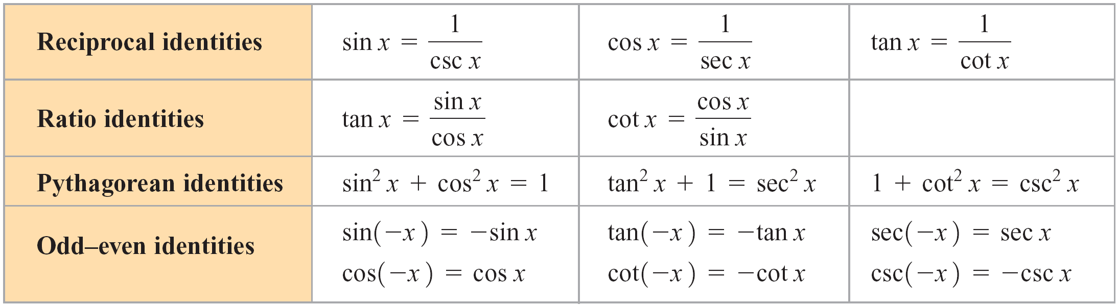
FUNDAMENTAL TRIGONOMETRIC IDENTITIES
Table 1: Fundamental Trigonometric Identities

Slide 4
VERIFICATION OF TRIGONOMETRIC IDENTITIES
To verify an identity, we show that one side of the identity can be rewritten in an equivalent form that is identical to the other side. There is no one method that can be used to verify every identity; however the following guidelines should prove useful.
Guidelines for Verifying Trigonometric Identities
If one side of the identity is more complex than the other, then it is generally best to try first to simplify the more complex side until it becomes identical to the other side.
Perform indicated operations such as adding fractions or squaring a binomial. Also be aware of any factorization that may help you to achieve your goal of producing the expression on the other side.

Slide 5
Use previously established identities that enable you to rewrite one side of the identity in an equivalent form.
Rewrite one side of the identity so that it involves only sine and/or cosines.
Rewrite one side of the identity in terms of a single trigonometric function.
Multiplying both the numerator and the denominator of a fraction by the same factor (such as the conjugate of the denominator or the conjugate of the numerator) may get you closer to your goal.
Keep your goal in mind. Does it involve products, quotients, sums, radicals, or powers? Knowing exactly what your goal is may provide the insight you need to verify the identity.

Slide 6
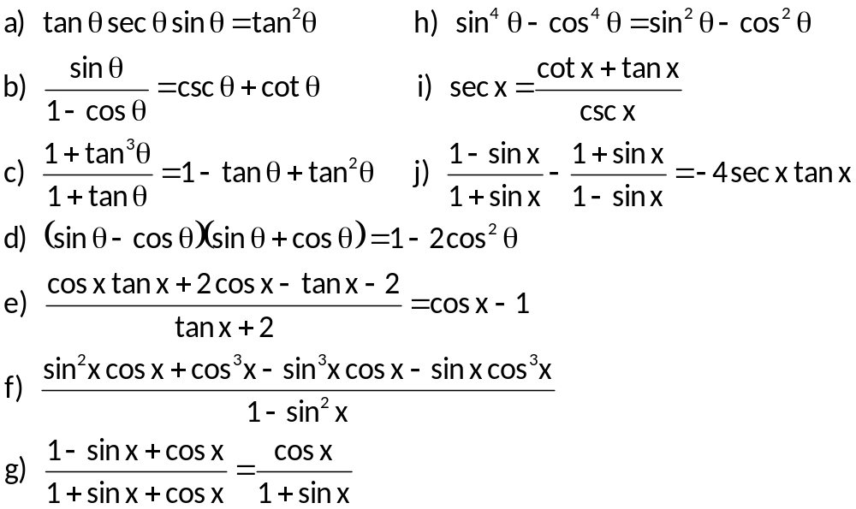
EXAMPLES
Verify the following identities.
Notes:
Week 5

Slide 7
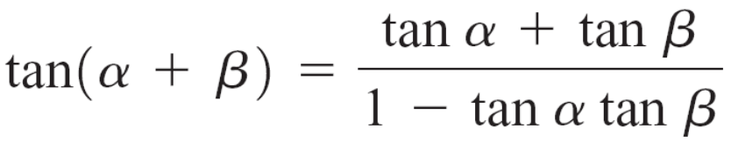
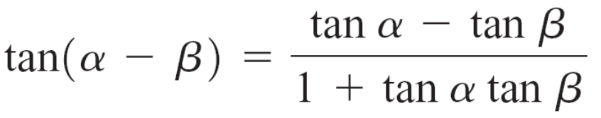
SUM AND DIFFERENCE IDENTITIES
cos (α – β) = cos α cos β + sin α sin β cos (α + β) = cos α cos β – sin α sin β
sin (α – β) = sin α cos β – cos α sin β sin (α + β) = sin α cos β + cos α sin β

Slide 8
EXAMPLES
Find the exact value of each trigonometric expression.
a) cos 75⁰ b) sin (π/12) c) tan 195⁰
Write each expression as a single trigonometric expression.
a) sin (–x) cos 3x – cos (–x) sin 3x
b) cos 4x cos (–2x) – sin 4x sin (–2x)
3. Find the exact value of a) cos (β – α) and b) sin (α + β), if
sin α = 24/25, α in QII, and cos β = – (4/5), β in QIII.
4. Verify the following identities:
a) cos (θ + π) = – cos θ
b) sin (α – β) – sin (α + β) = – 2 cos α sin β
Notes:
plane

Slide 9
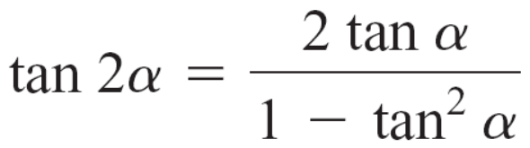
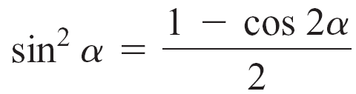
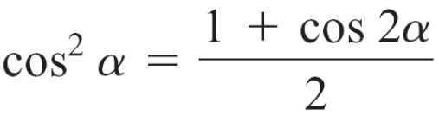
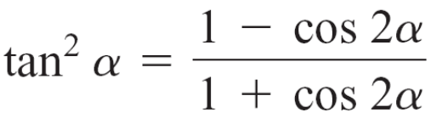
DOUBLE – ANGLE IDENTITIES
Sine | Cosine | Tangent
sin 2α = 2 sin α cos α | cos 2α = cos² α – sin² α
 | cos 2α = 1 – 2 sin² α
 | cos 2α = 2 cos² α – 1
POWER–REDUCING IDENTITIES
Notes:
Week 5

Slide 10
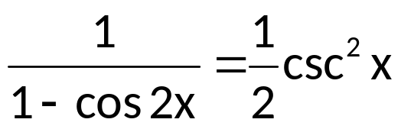
EXAMPLES
Write each trigonometric expression in terms of a single trigonometric function .
a) 2 sin 3θ cos 3θ b) cos²(x + 2) – sin²(x + 2)
If cos α = 24/25; 270⁰ < α < 360⁰, find a) sin 2α b) cos 2α
and c) tan 2α
Use the power–reducing identities to write each trigonometric expression in terms of the first power of one or more cosine funtions.
a) cos⁴ α b) sin² x cos⁴ x
4. Verify :
a) cos 8x = cos² 4x – sin² 4x b)
Notes:
plane

Slide 11
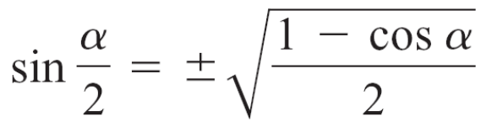
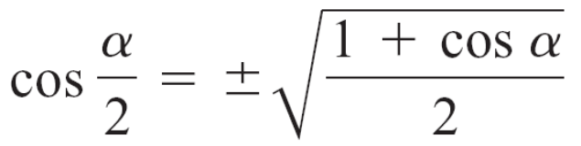
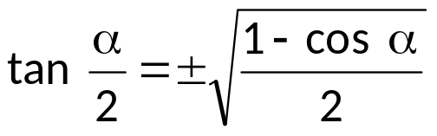
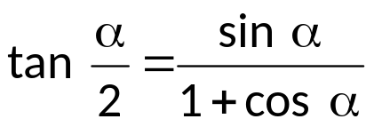
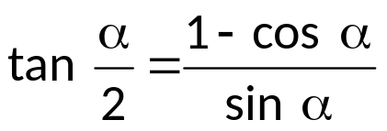
HALF – ANGLE IDENTITIES
Sine | Cosine | Tangent
Notes:
Week 5

Slide 12
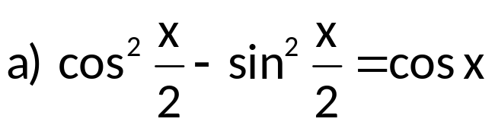
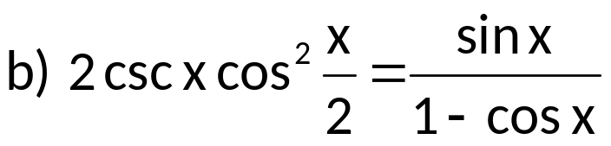
EXAMPLES
Use half – identities to find the exact value of each trigonometric expression.
a) cos 105⁰ b) sin (3π/8) c) cot 67.5⁰
Find the exact value of the sine, cosine, and tangent of (α/2) given the following information.
a) cos α = 12/13, 0⁰ < α < 90⁰
b) csc α = – (5/3), α is in Quadrant IV
3. Verify the following identities :
Notes:
plane

Slide 13
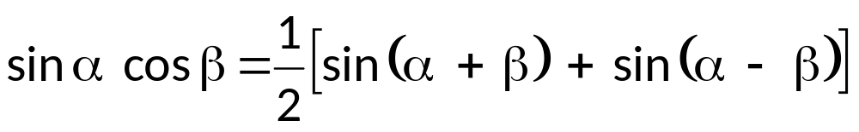
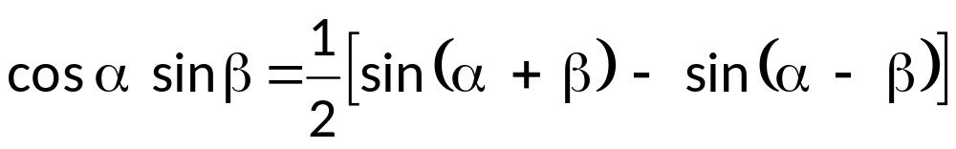
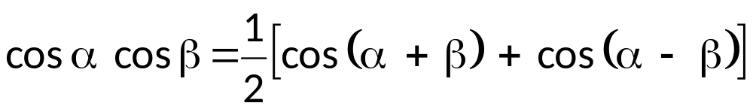
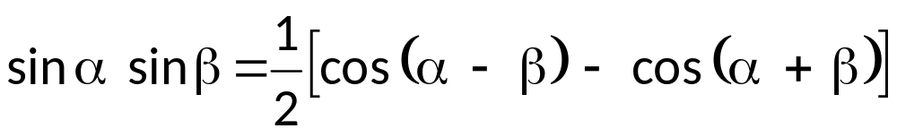
PRODUCT – TO – SUM IDENTITIES
Notes:
Week 5

Slide 14
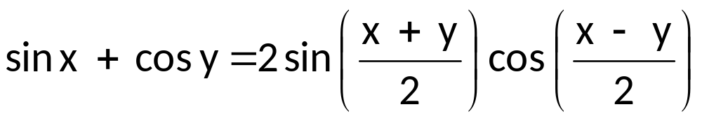
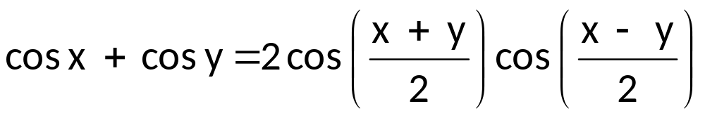
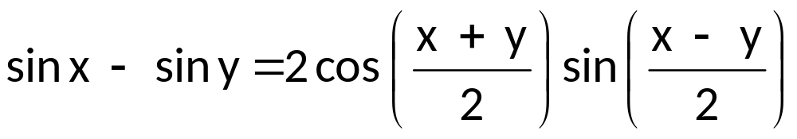
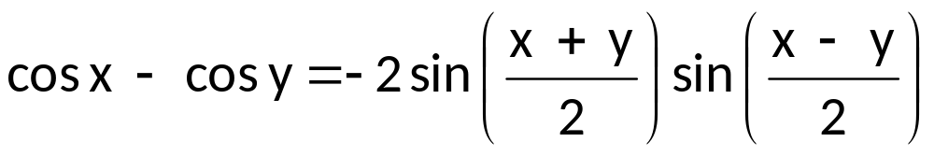
SUM – TO – PRODUCT IDENTITIES
Notes:
Week 5

Slide 15
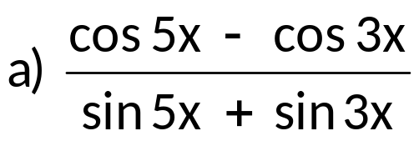

EXAMPLES
Write each expression as a sum or difference of sines and/or cosines.
a) 2 sin 4x sin 2x b) 4 cos (– x) cos 2x
c) sin (3x/2) sin (5x/2) d) sin (–πx/4) cos (–πx/2)
Write each expression as a product of sines and/or cosines.
a) cos 5x – cos 3x b) sin (3x/4) + sin (x/2)
c) sin (0.4x) – sin (0.6x) d) cos (–πx/4) + cos (πx/6)
3. Simplify the following trigonometric expressions.
Notes:
plane

